Slide 1
Malum per Die…
An Apple a Day…

Slide 2
Wedding of Peleus and Thetis

Slide 3
Eris (Discord)

Slide 4
καλλεστι

Slide 9
Atalanta and Hippomenes

Slide 10
Atalanta and Hippomenes

Slide 13
Golden Apples of the Hesperides

Slide 14
11th of Hercules’ 12 Labors

Slide 15
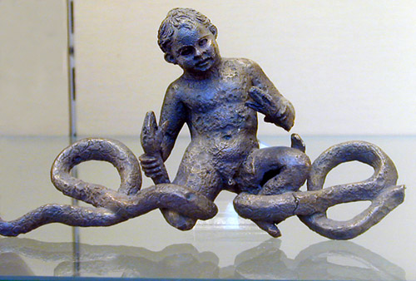
Hercules’ Labors…Why?

Slide 16
Eurystheus, King of Tiryns and Mycenae

Slide 17
Gardens of the Hesperides, Daughters of Atlas
Problem for Hercules… Where are they?
They are in the north which Hercules doesn't find out until later. He travels the whole world looking for them.
The golden apples were a wedding gift from Hera to Zeus.
The apples were guarded by the Hesperides (daughters of Atlas) and a three headed serpent named Ladon.

Slide 18
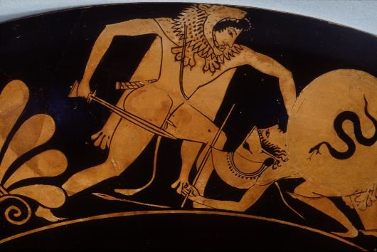
As he travels looking for the Gardens…Kyknos (son of Ares)
Fought was broken up by a lightning bolt.

Slide 19
In Illyria…Nereus who knows the location of the apples
As he fights Hercules, he changes his shape in order to escape his hold. Squeezing tightly, Hercules does not let go and Nereus, the sea-god, is forced to tell the location of the Gardens of the Hesperides.

Slide 20
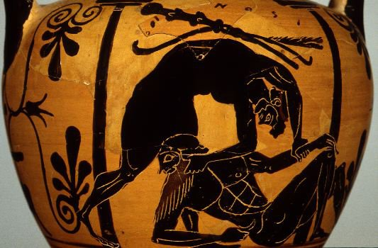
Now to the Gardens…but…
Antaeus and Busiris, sons of Poseidon

Slide 21
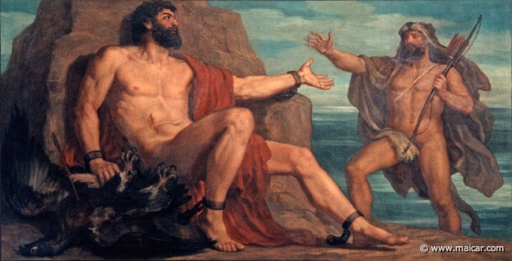
Prometheus on Mt. Caucasus
As a reward, he tells Hercules HOW to get the golden apples…

Slide 22
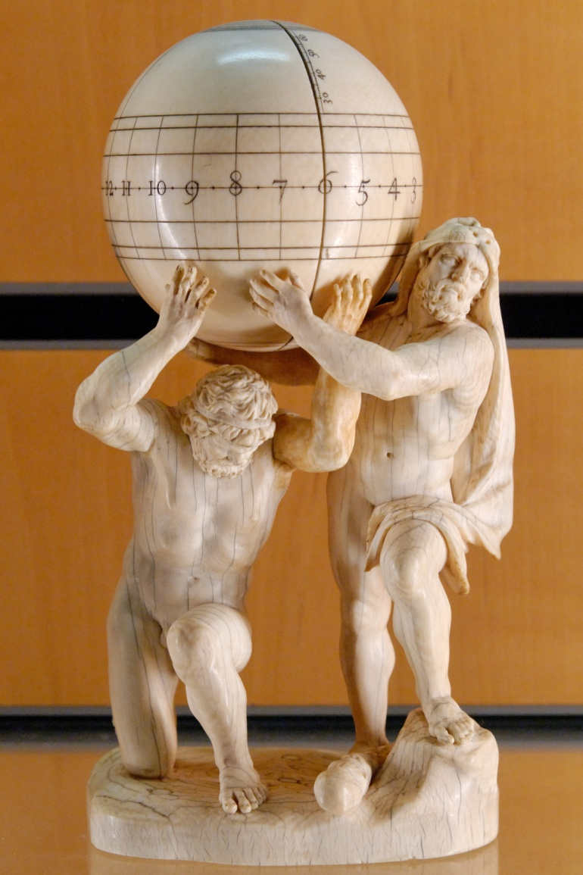
Deception Atlas vs. Hercules
Prometheus: “You have to send Atlas to get them”.

Slide 23
Hercules deceives Atlas

