Slide 1
Theseus and the Minotaur

Slide 2
Players/Places
King Minos
Pasiphae
Ariadne
Daedalus
Icarus
Theseus
Poseidon
Bacchus
Androgeus
Pallantides
King Aegeus
Phaedra
Cape Sounion
Pan-Athenian Games
Athens
Aethra
Troezen
Medea

Slide 3
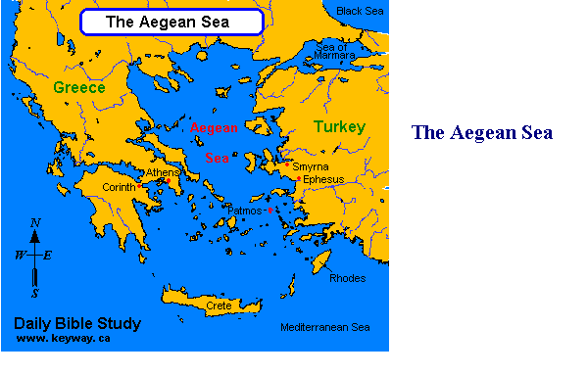

Slide 4
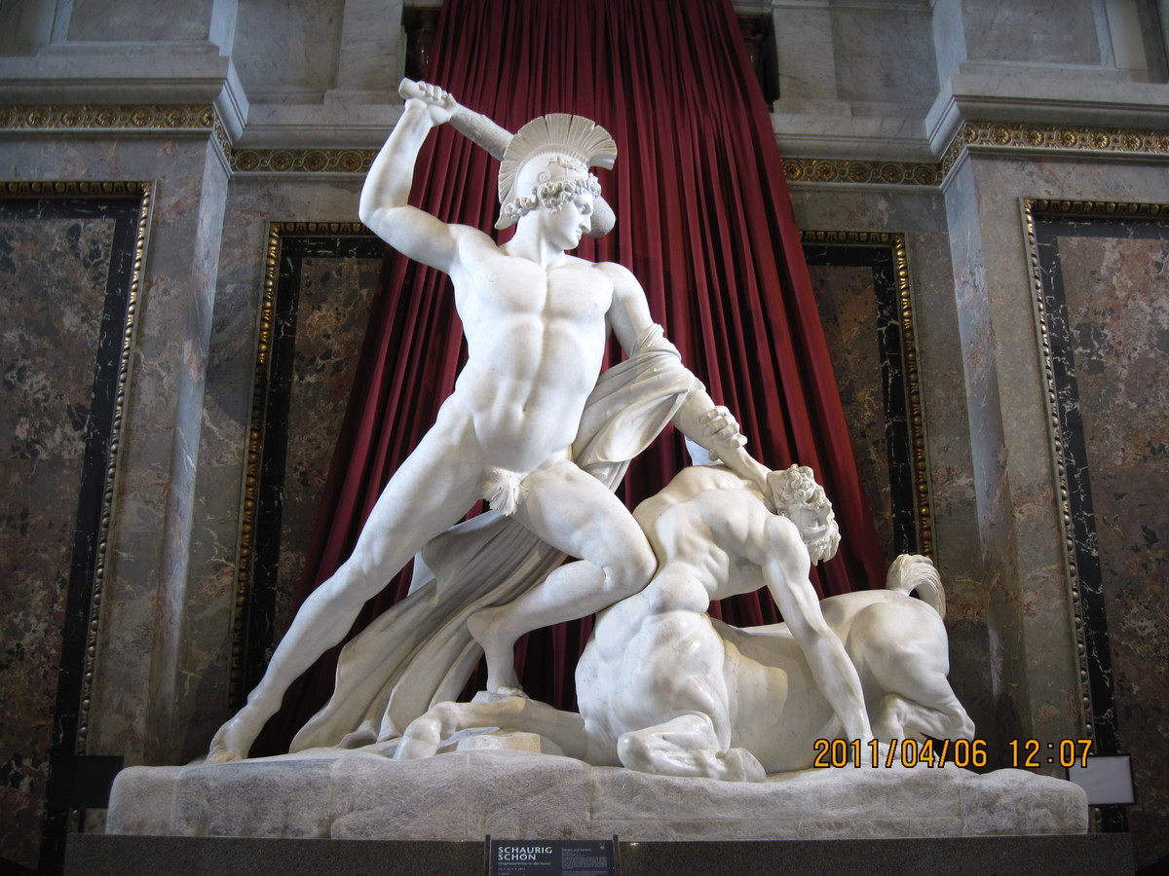

Slide 5
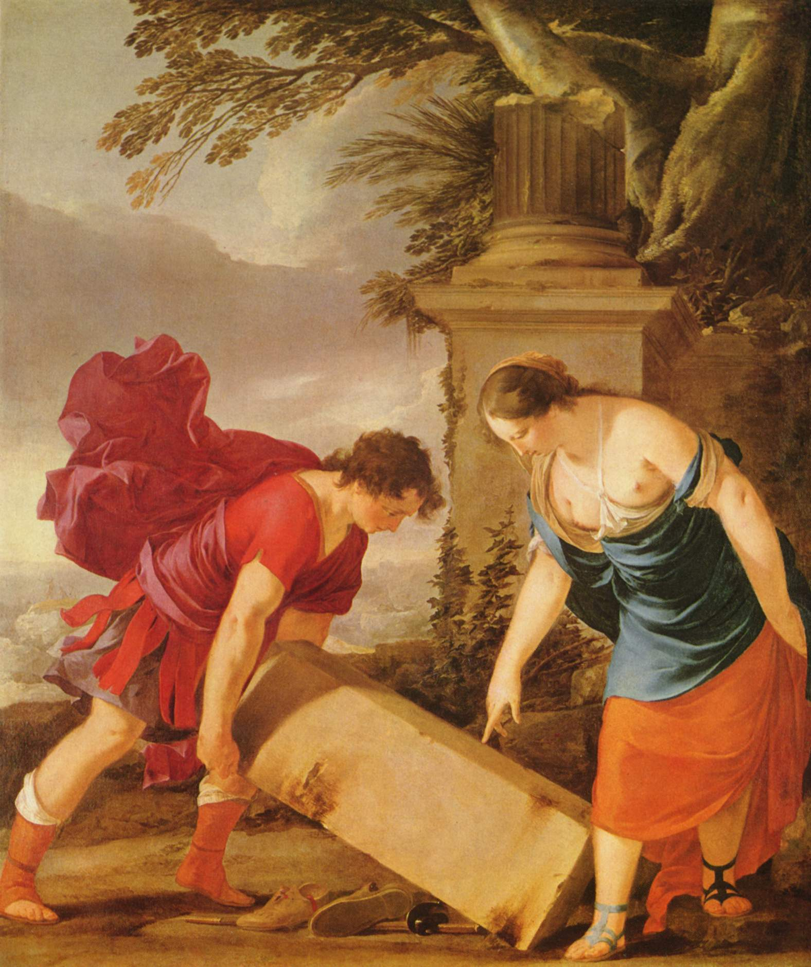

Slide 6
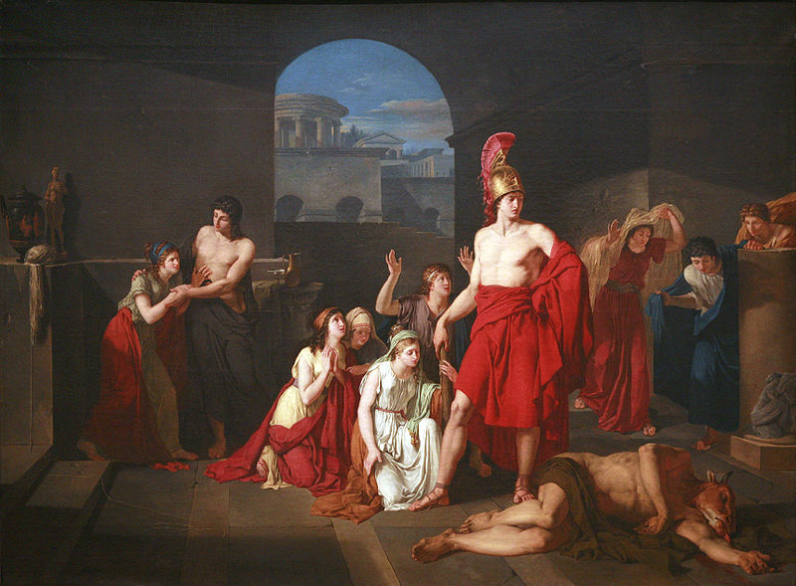

Slide 7
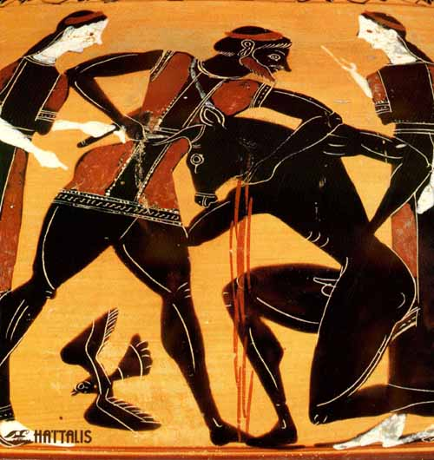

Slide 8
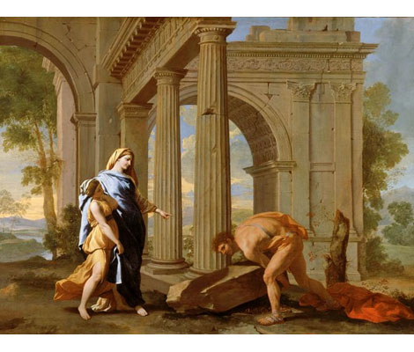

Slide 9
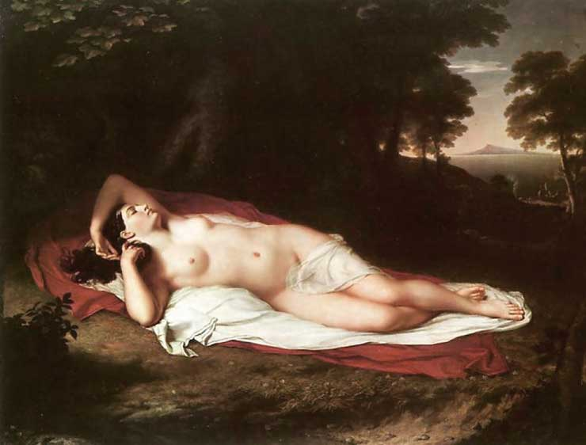

Slide 10
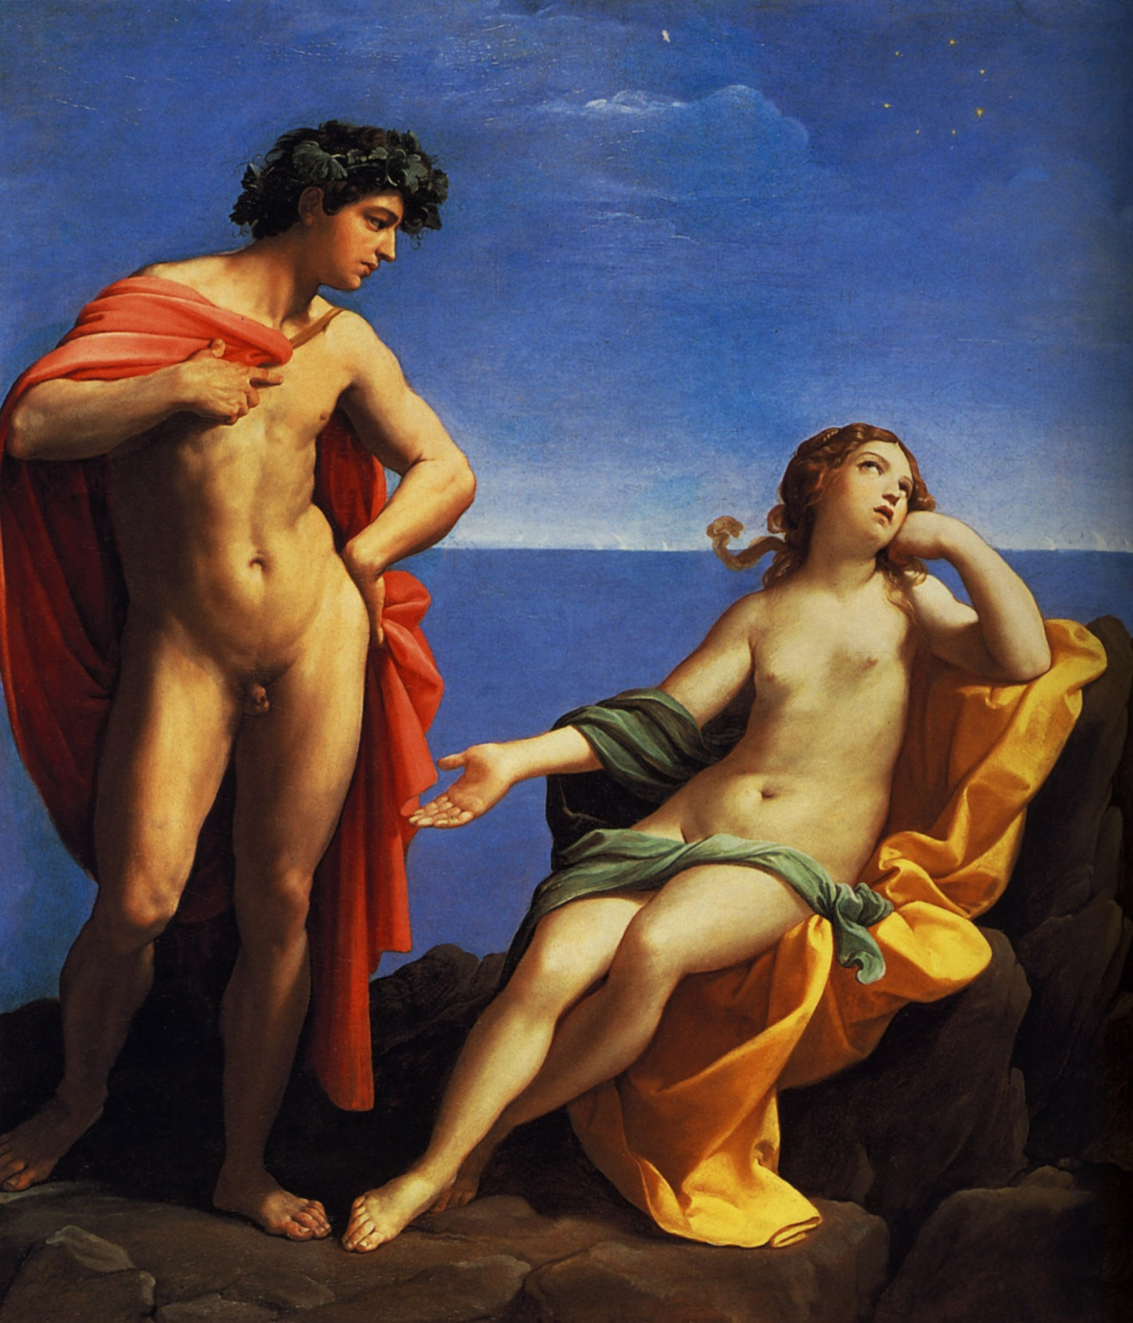

Slide 11
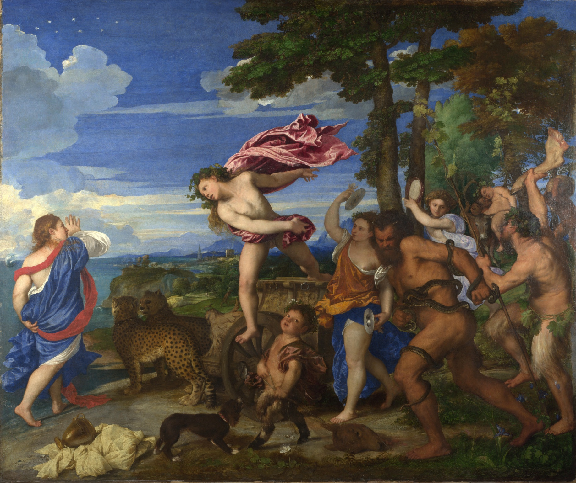

Slide 12
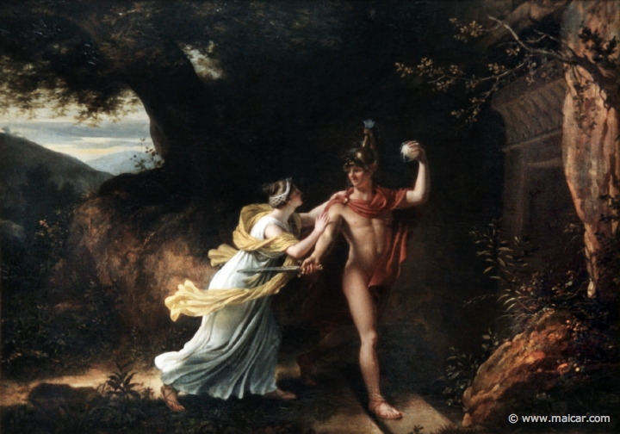

Slide 13
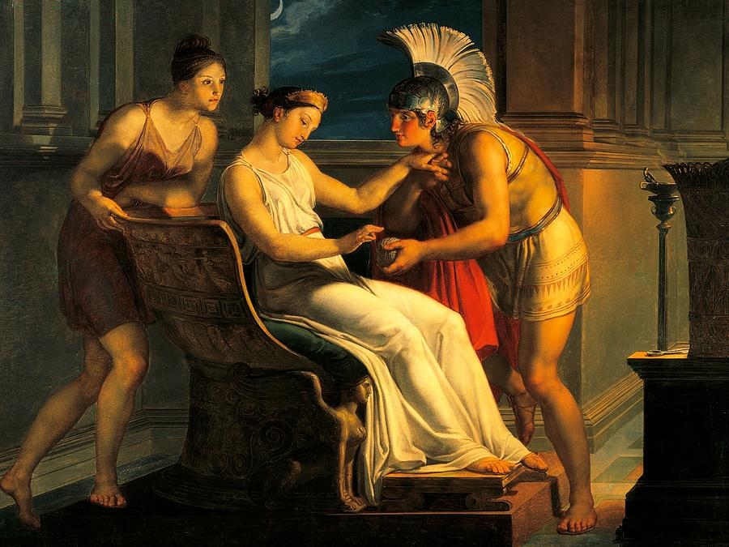

Slide 14
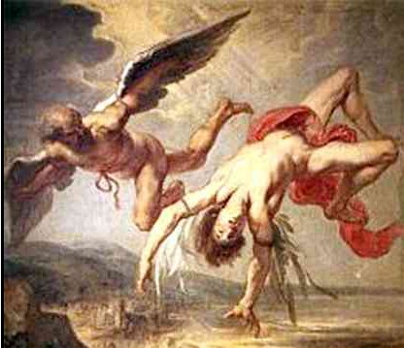

Slide 15
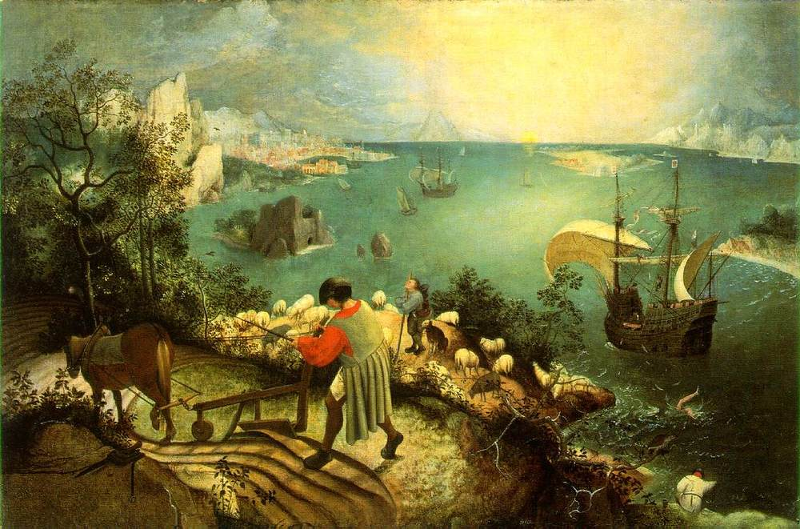

Slide 16
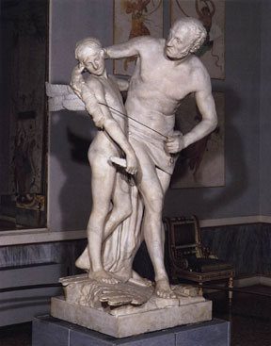

Slide 17
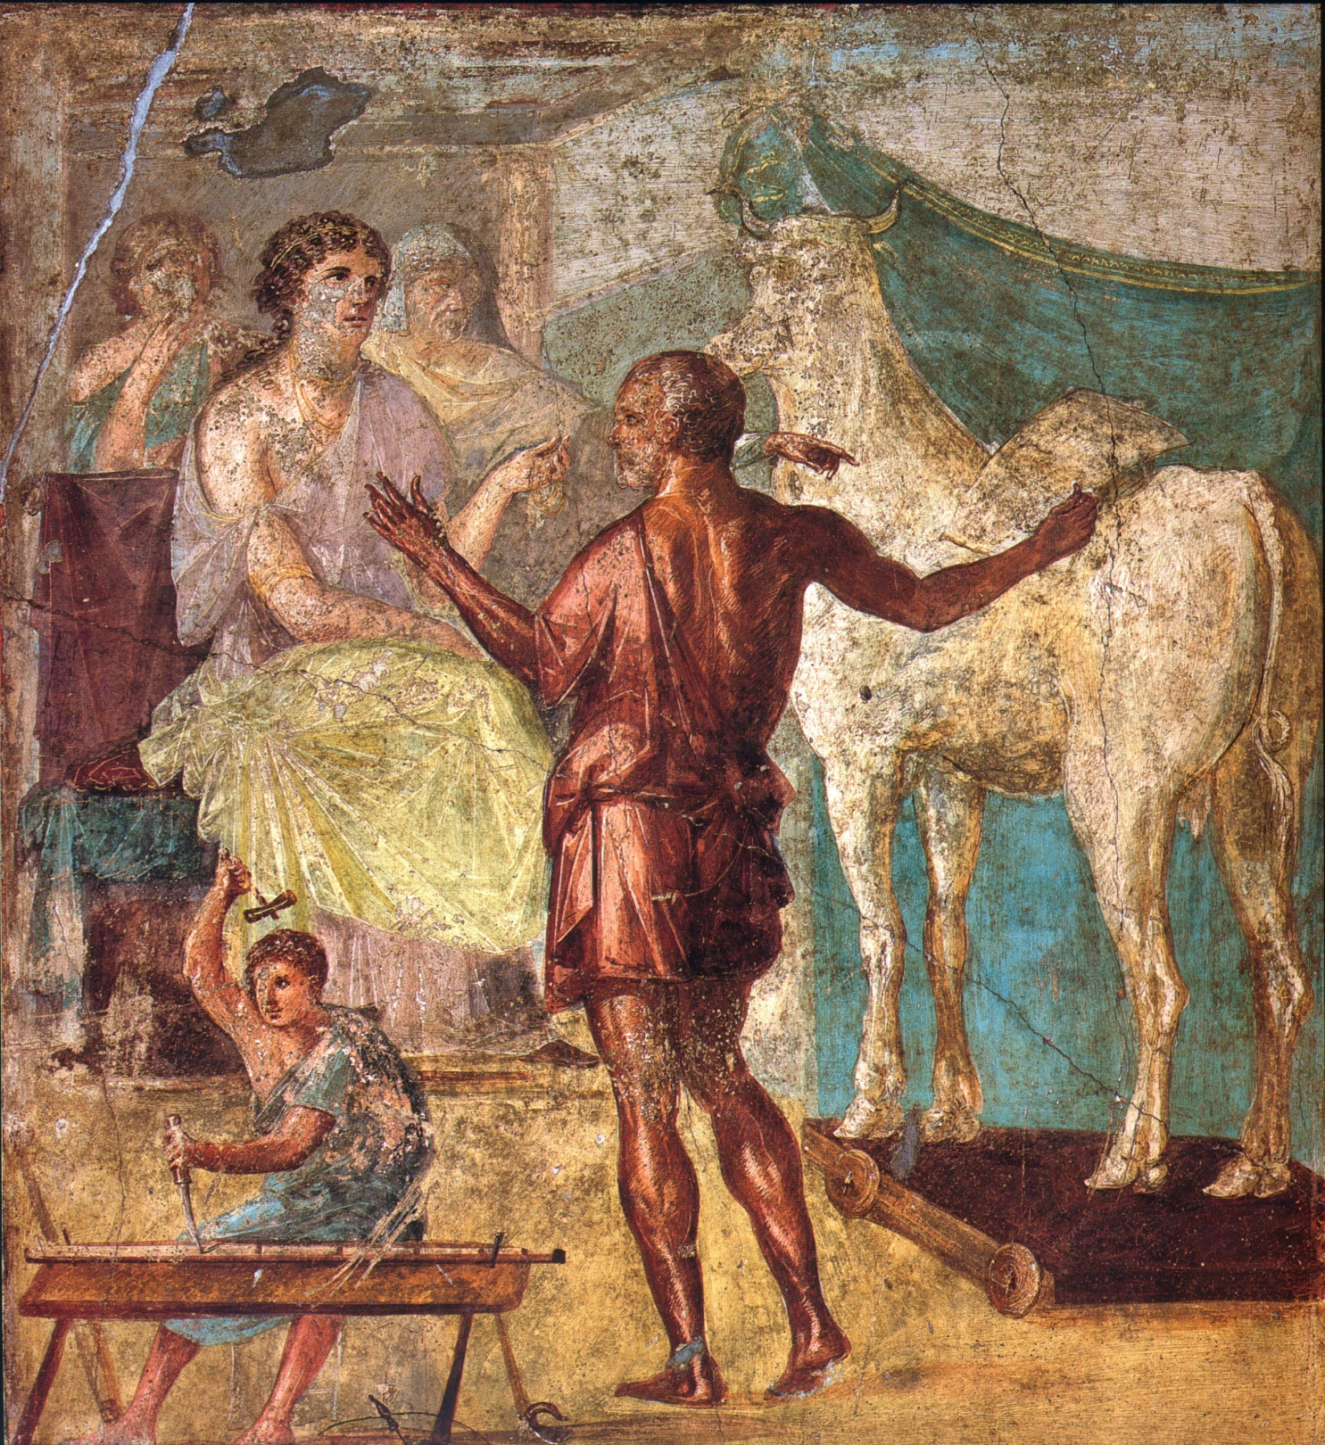

Slide 18
